Slide 1


MSBA CAPSTONE
MSBA CAPSTONE
CUSTOMER SUCCESS PREDICTION
MSBA CAPSTONE
SRI CHANDAN CHINTA, SAHITH REDDY CHINTALA, SHREYA ROKATI

Slide 2

CONTENTS:
Company Overview
Business Problem
Overview of dataset
EDA
Data Pre-processing
Model selection & Insights
Next Steps & Future Ideas
Executive Summary

Slide 3
COMPANY OVERVIEW:
Swire Coca-Cola, USA produces, sells and distributes Coca-Cola and other beverages in 13 states across the American West.
The organization uses analytics in various ways to make informed business decisions and improve its operations.

Slide 4
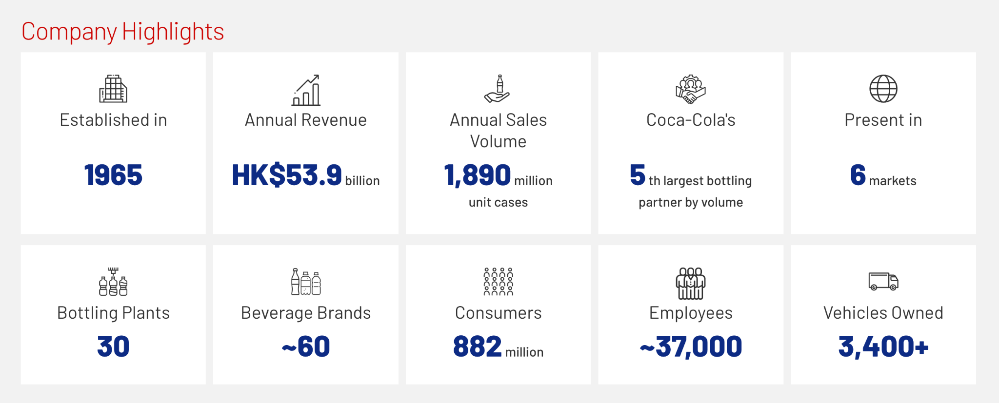
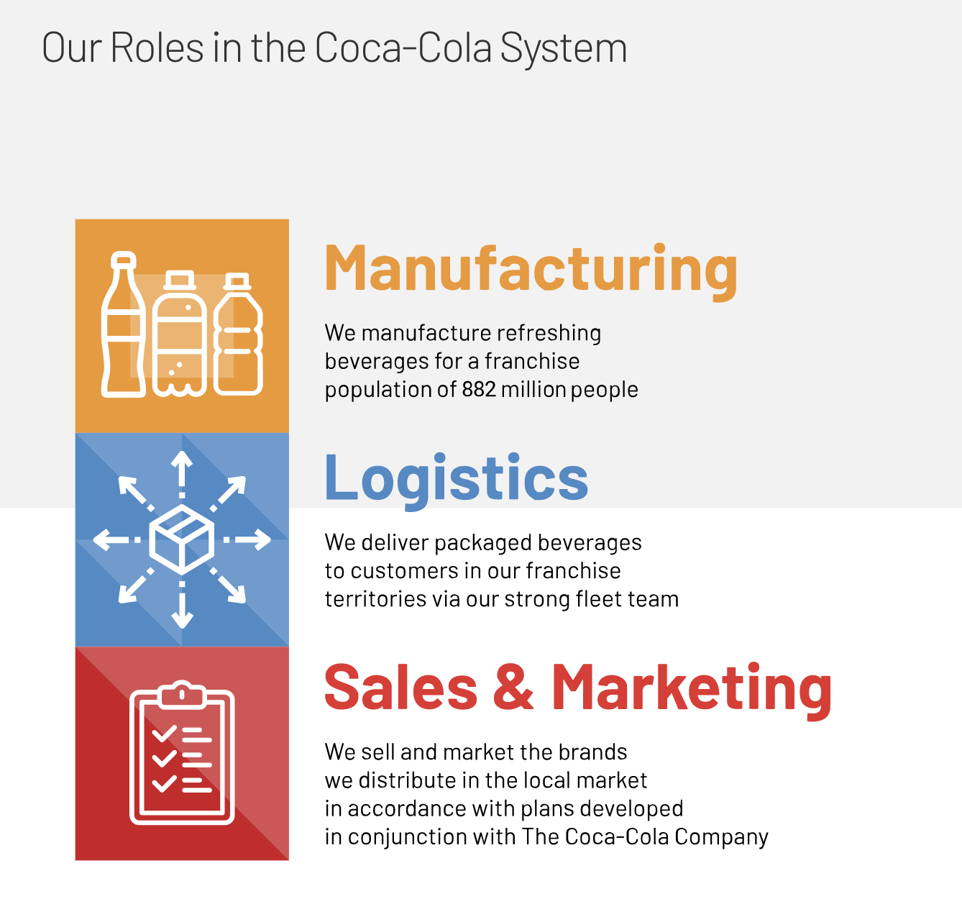
COMPANY OVERVIEW:

Slide 5
BUSINESS PROBLEM:
The success of Swire Coca-Cola's business largely depends on local establishments such as restaurants, and when considering potential partnerships. The company must carefully evaluate the profitability of the venture and assess the risk of any potential losses with the new partnership.

Slide 6
OVERVIEW OF DATASET:
2 Data sets : Customer Data, Sales Data
The customer dataset gives an overview of the attributes of the customers.
The sales dataset give more details of the products and the financial metrics of the customers.
No. of fields in dataset:
Customer : 15
Sales: 16

Slide 7
EDA
PART ONE
01
EDA helps Swire-Coca Cola to consider factors that will help them to predict the profitability and decrease losses as well.

Slide 8
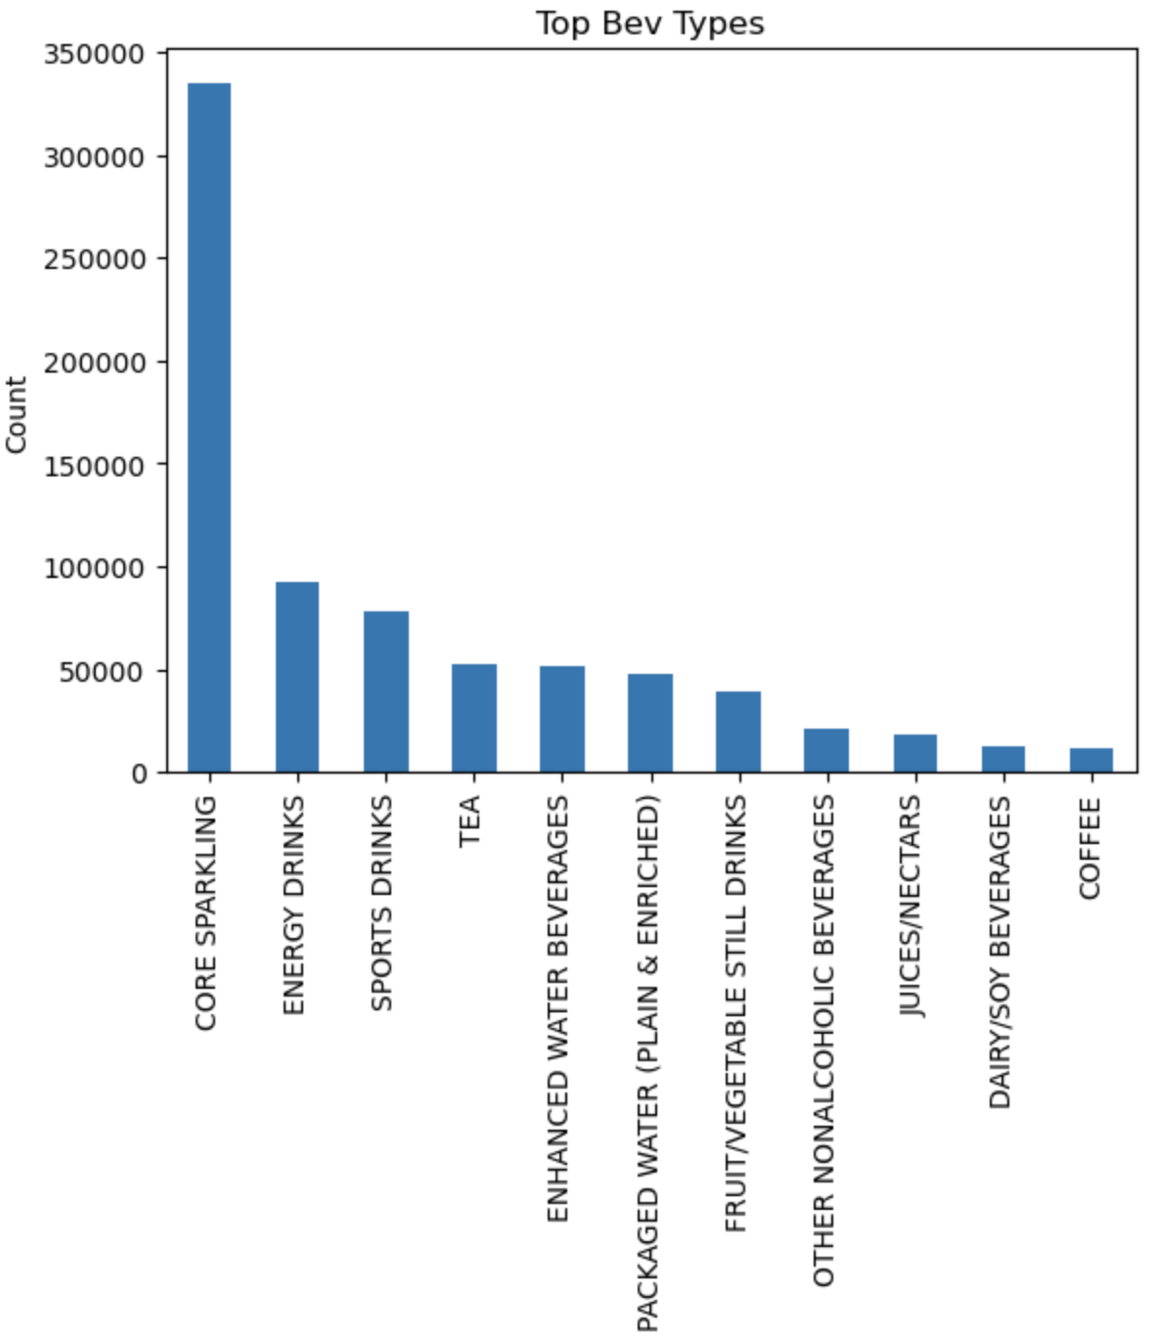
Metric 1
Sales of each Beverage type
Beverage type has a significant effect on sales. Core Sparkling beverages sells more than all the other combined.
This data will also help us improve our marketing and advertising strategies to improve sales of other beverages as well.

Slide 9
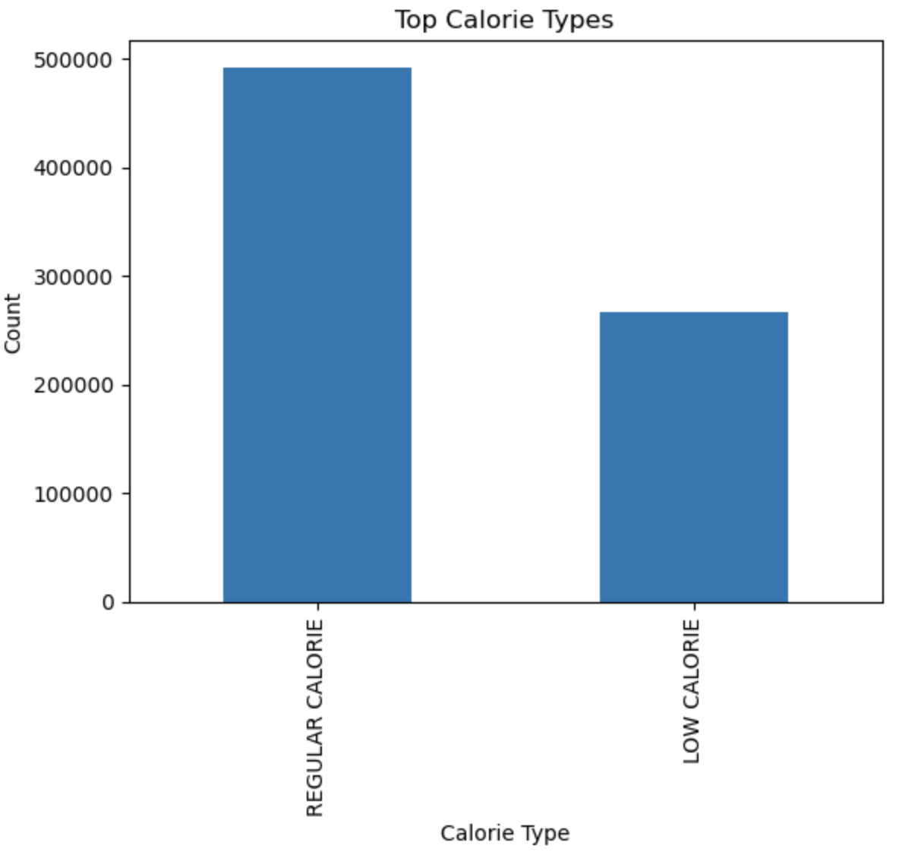
Metric 2
Calories of Beverage vs Sales
Regular calorie beverages have more probability to be sold and has less risk of loss.

Slide 10
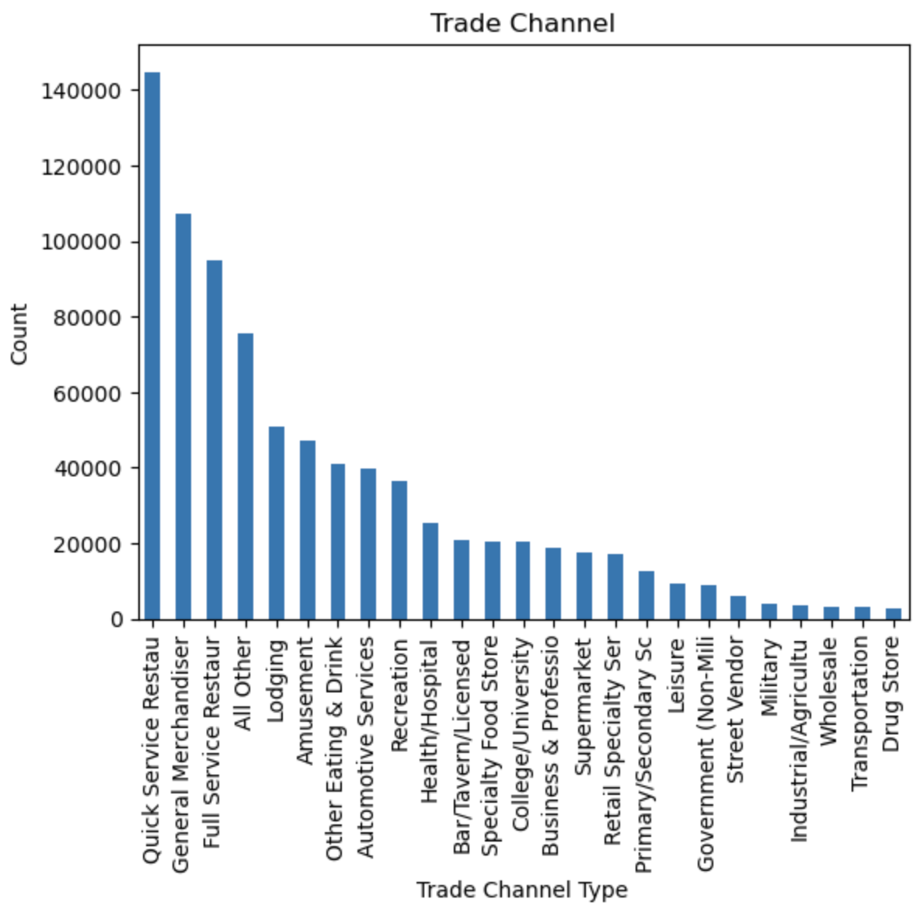
Metric 3
Sales in each trade channel
2 of the top 3 trade channels with most sales serve food.

Slide 11
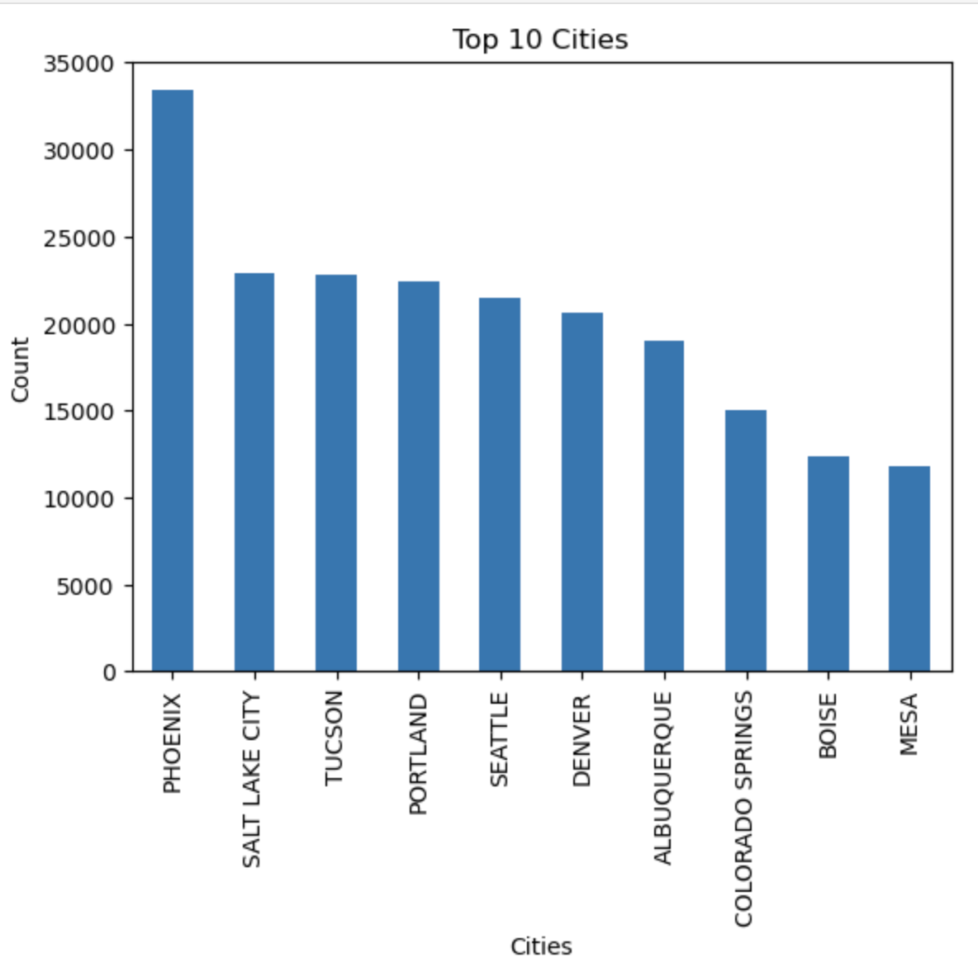
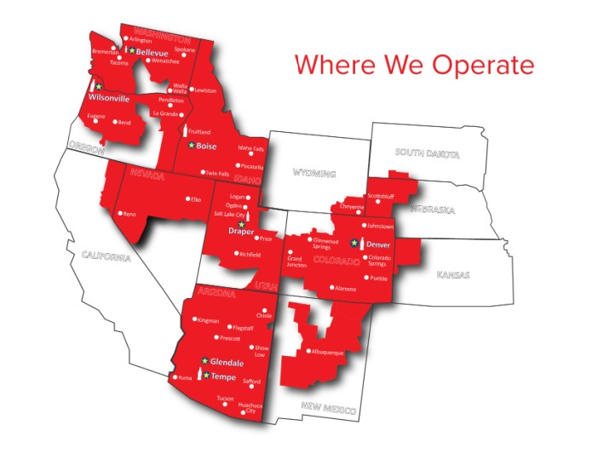
Metric 4
Sales in each City.

Slide 12
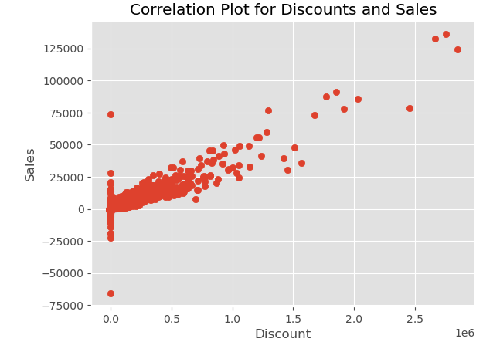
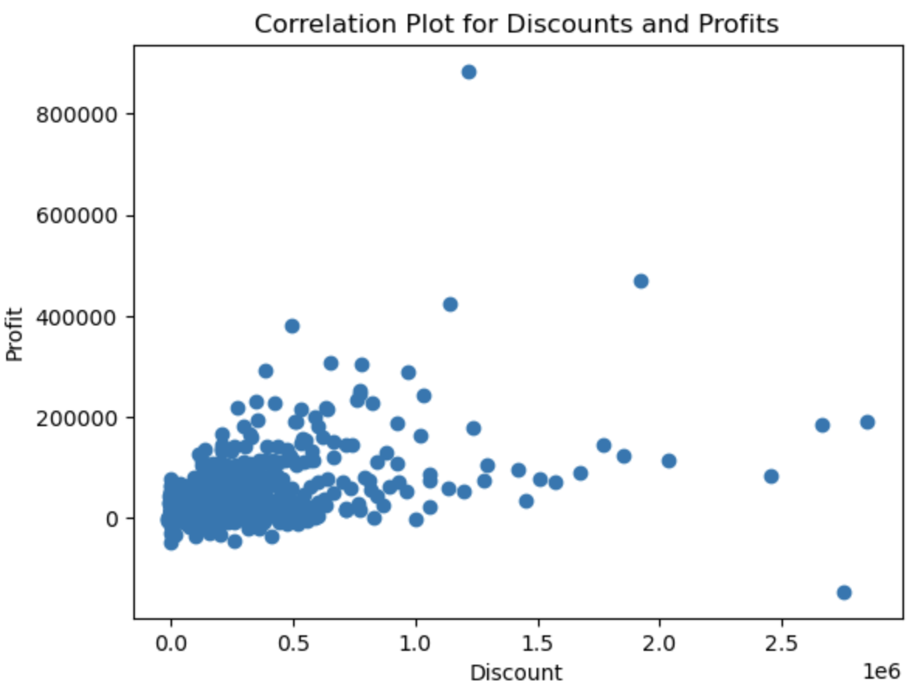
Metric 5
Correlation of Profit VS Discount and Sales

Slide 13
Modelling
PART ONE
02
Predict profitability from various factors.

Slide 14





Modelling
Tools used for modelling.
We have used Python, Tensorflow, ScikitLearn, Numpy and Pandas to build Machine Learning and Deep learning Models to predict Physical volume of the sales.

Slide 15
Modeling
We have build both Machine Learning and Deep learning models to predict Physical Volume of the customers.
We know that increase in the Physical Volume will in turn increase the revenue of the customer there by Swire Coca-Cola.
Customers and Swire Coca-Cola can use this model to input various dependent variables and see how it is affecting the physical volume in turn.

Slide 16
Data Pre-processing
We have combine both the sales and customer data frames provided and then used the label encoder to convert the datatypes of the features to float.
We have dropped few features which add little to no value to the model.

Slide 17
Modeling
Splitting the data for training and testing
We have split the data in the ratio of 70 to 30.

Slide 18
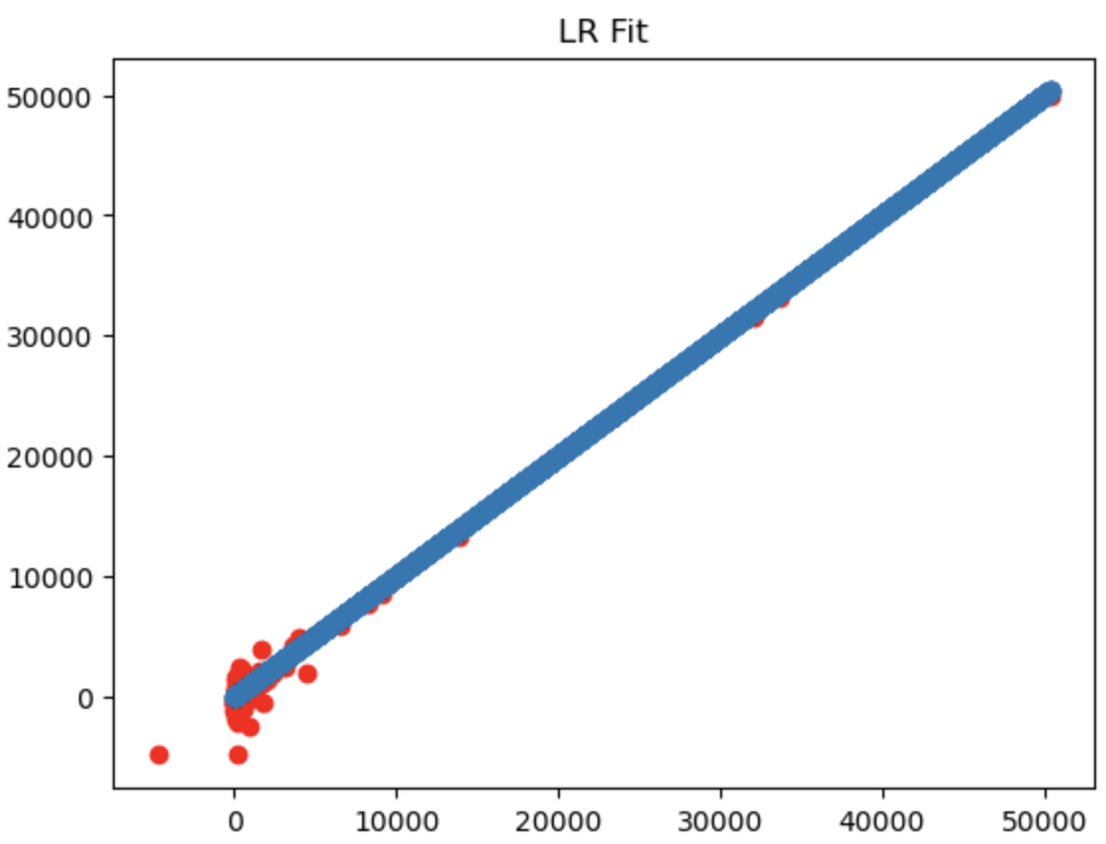
Modeling
Linear Regression Machine Learning Model
With the data available and the use case, we found out that Linear Regression works the best.

Slide 19
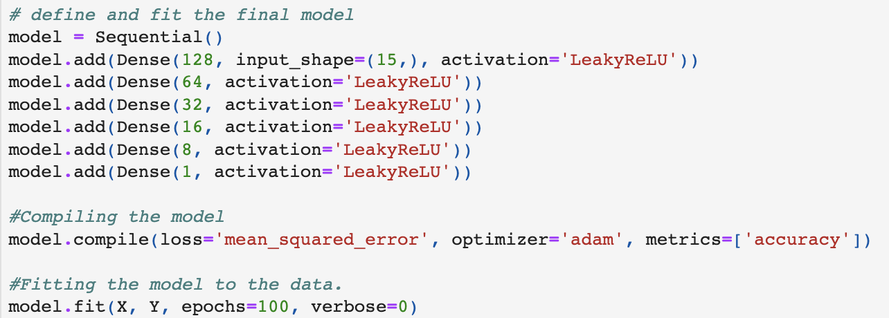
Modeling
Deep Learning Model
We also built a Deep Learning model which provides us more customization to enhance our predictions.

Slide 20
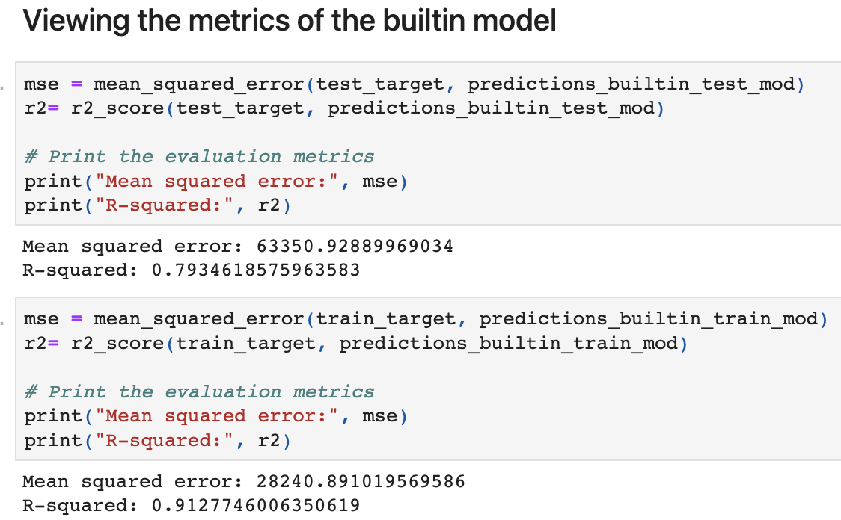
Model İnsights
Predictions of Linear Regression model
On the test data we got MSE of 63350 and R-Squared of 0.79.
On the training data we got MSE of 28240 and R-Squared of 0.91

Slide 21
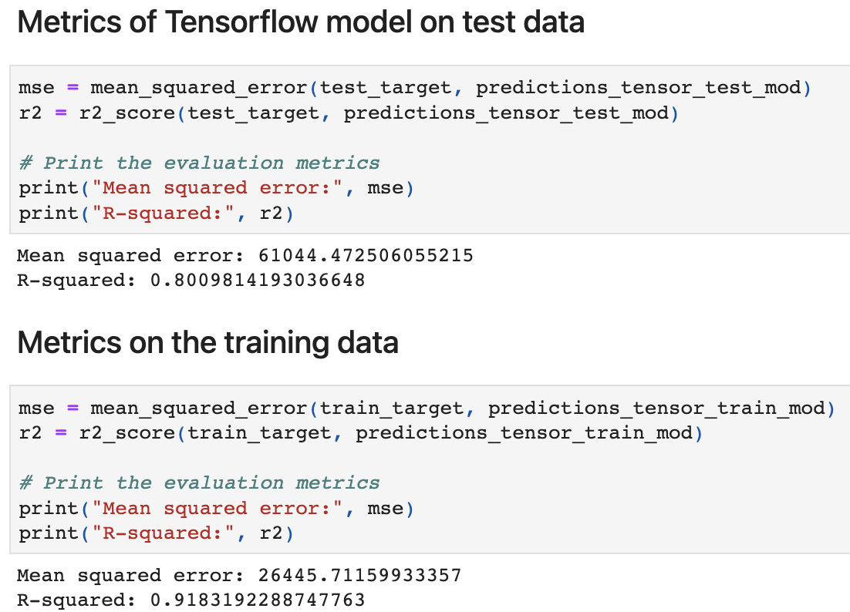
Predictions of Deep Learning model
On the test data we got MSE of 61044 and R-Squared of 0.80.
On the training data we got MSE of 26445 and R-Squared of 0.91

Slide 22
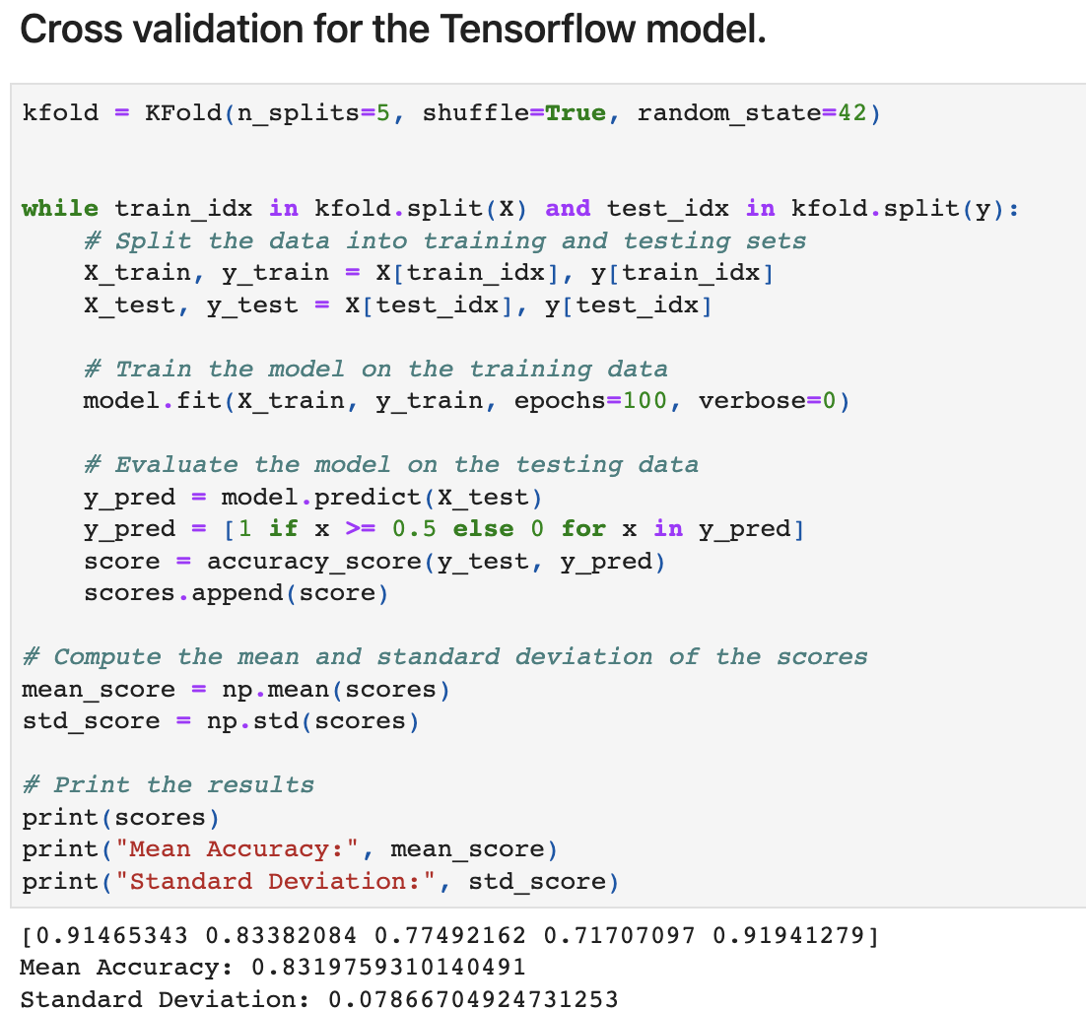
Cross Validation of the Deep Learning Model
With cross Validation we got a mean accuracy of 0.83 and standard deviation of 0.078.

Slide 23
Next Steps and Future Ideas:
This model's results can be utilized to offer customized pricing to individual customers, taking into account their sales capability.
Swire can use this model to predict physical volumes to each region and plan supply chain activities to reduce loss from excess inventory and delays in delivery.

Slide 24
Executive Summary:
Physical Volume is a better metrics in evaluating profitability of the business when compared to popularity and longevity.
Deep learning model can be useful in accommodating new input variables.
Applying this method would assist the company in discovering a beneficial alliance.

Slide 25
Any Questions & feedback?

Slide 26
THANK YOU !

